Slide 1
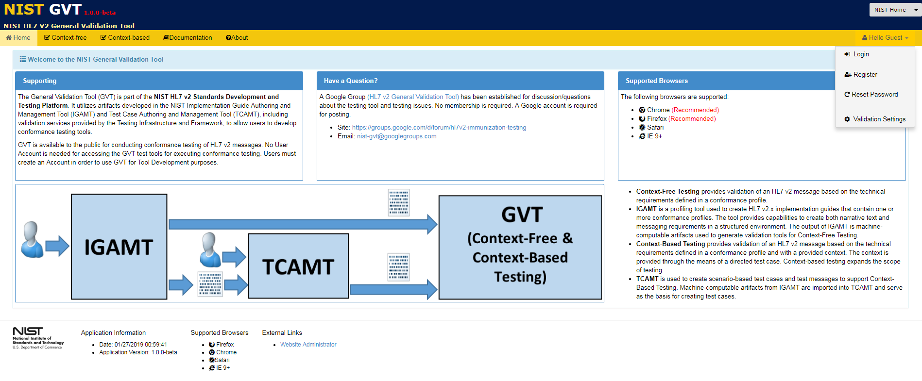
Accessing GVT as a Guest User
When GVT is accessed, NIST Home is the default Tool Scope for all users.
Click on Tool Scope dropdown menu to select other Tool Scopes.
Hello Guest drop down menu allows a user to:
Login, if user is registered in GVT
Register, if user wants a GVT account for Test Management capabilities (e.g., building test tools)
Request Reset of their Password, if user is registered
Set validation options (e.g., generation of Error and Alert notifications during message validation)
The NIST Home Tool Scope allows:
Access to Public validation tools in the NIST Home group of tools
Access to NIST Home Tool Scope documentation for GVT

